Slide 1
Chapter 5
Game Playing

Slide 2
Roadmap
Minimax algorithm
Minimax algorithm with Alpa-Beta cutoffs

Slide 3
Game Palying
One of well-known algorithms in game playing is Minimax Algorithm. We mean by game playing is the games that are played by two players (the computer and the user). Games that can be played with the computer only is done by A* algorithm.

Slide 4
Minimax Algorithm
It is a depth search with look a head. In general, and in any game, the more we can look a head, the more is our opportunity to win. In this algorithm we need
1. Node Generator 2. Evaluation Function
Node Generator is to explore the nodes that might immerge base on the current node. This works for both the players.
Evaluation function is a function that can evaluate the current state of the node.

Slide 5
Minimax Algorithm
The MAX represents the player trying to win, or to maximize his/her advantages.
MIN is the opponent who attempts to minimize MAX's score. We assume that MIN uses the same information and always attempts to move to a state that is worst for MAX.
What is Computer (Max or Min): If the parent state is MAX node, give it the maximum value among its children. If the parent is a MIN node, give it the minimum value of its children.
The method universally used (checkers, chess, go, othello...) is called Minimax.

Slide 6
Minimax Algorithm

Slide 7
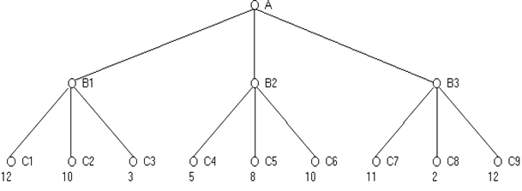
Minimax algorithm

Slide 8
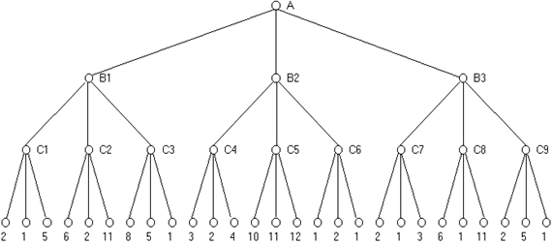
Minimax algorithm

Slide 9
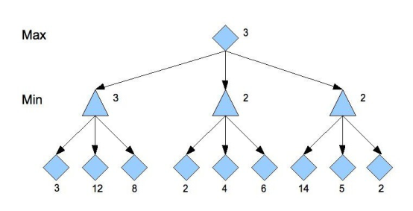
Minimax algorithm

Slide 10
Minimax algorithm

Slide 11
Minimax algorithm

Slide 12
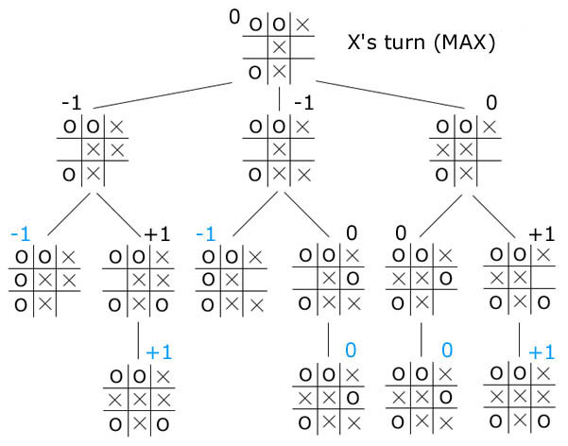
Minimax algorithm

Slide 13
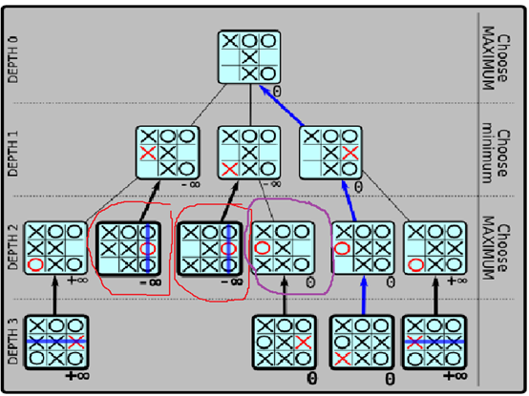
Minimax algorithm

Slide 14
Alpha Beta Cutoffs
The idea is simple rather than searching the entire space to the ply depth, alpha-beta search proceeds in a depth first fashion. Two values, called alpha and beta are created during the search. The alpha value, associated with max nodes, can never decrease, and the beta value, associated with Min nodes, can never increase. The rules are :
1. Search can be stopped below any Min node having a beta value less than or equal to the alpha value of any of its Max ancestors.
2. Search can be stopped below any Max node having any alpha value greater than or equal to the beta value of any of its Min node ancestors.

Slide 15
Minimax with alpha-Beta cutoffs

Slide 16
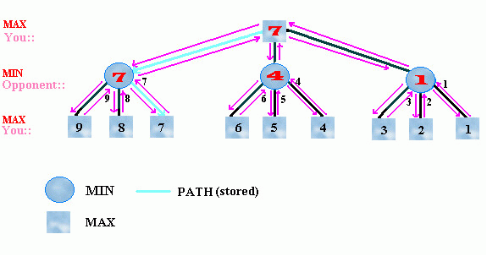
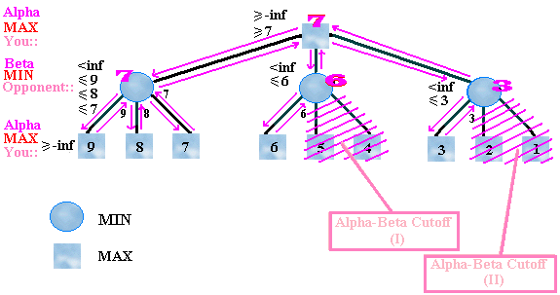
Minimax with alpha-Beta cutoffs

Slide 17
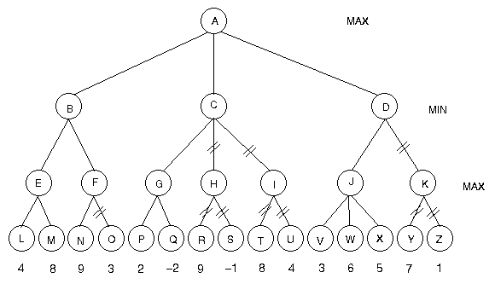
Minimax with alpha-Beta cutoffs

Slide 18
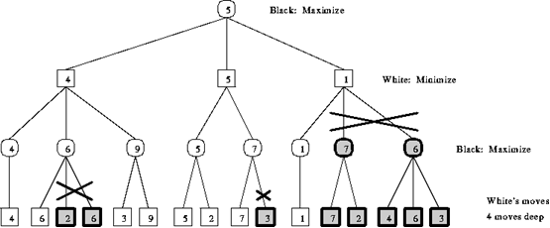
Minimax with alpha-Beta cutoffs

Slide 19
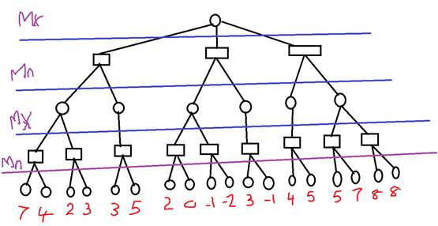
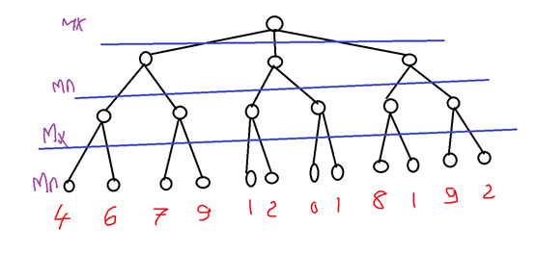
Minimax with alpha-Beta cutoffs

Slide 20
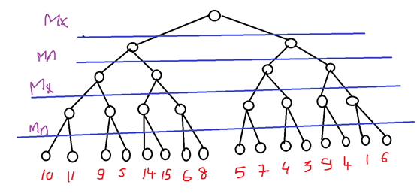
Minimax with alpha-Beta cutoffs

Slide 21
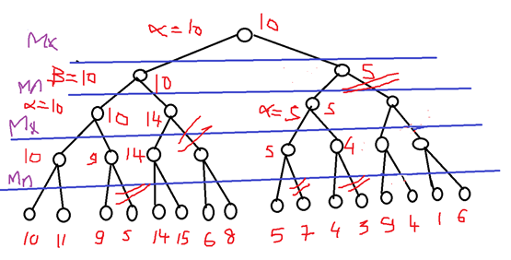
Minimax with alpha-Beta cutoffs

